Slide 1
Forecasting December 2025 consumer Spending
Vicki Taylor
Nashville Software School Data Science Cohort 8
July 10, 2025

Slide 2
Project Summary
Purpose:
Forecast December 2025 consumer spending as it is a good indicator on economic health and consumer confidence
Focus:
Impact of economic indicators on future spending
Motivation:
Critical insights for businesses in an evolving economic climate

Slide 3
Data Questions
Can a predative model using historical data on US consumer debt, spending, inflation, and unemployment rates forecast personal consumer expenditures for December 2025?
How do inflation, unemployment, and consumer debt indicators relate to historical spending?

Slide 4
Data Sources and Preparation
Sources:
Inflation: Federal Reserve Economic Data
Unemployment: US Bureau of Labor Statistics
Consumer Debt: Federal Reserve
Personal Consumption Expenditures: Bureau of Economic Analysis
Preparation:
Standardize date formatting
Handling null values for revolving debt
Added lag features to give historical values to the model

Slide 5
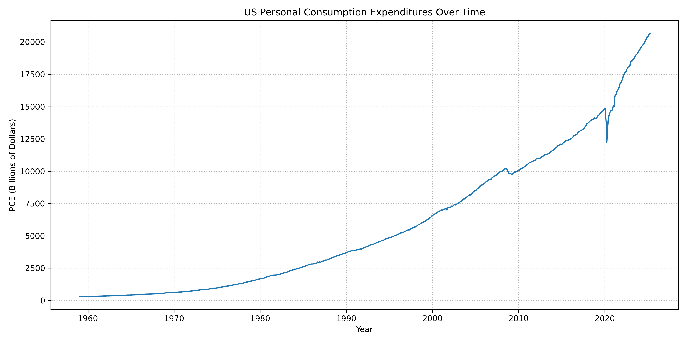
History of spending

Slide 6
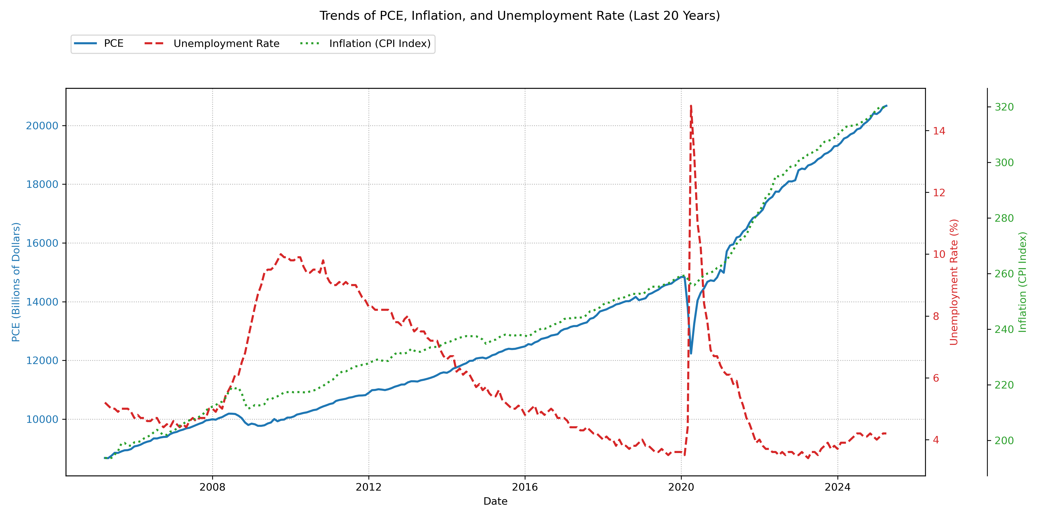
20 Year Comparison Trend

Slide 7
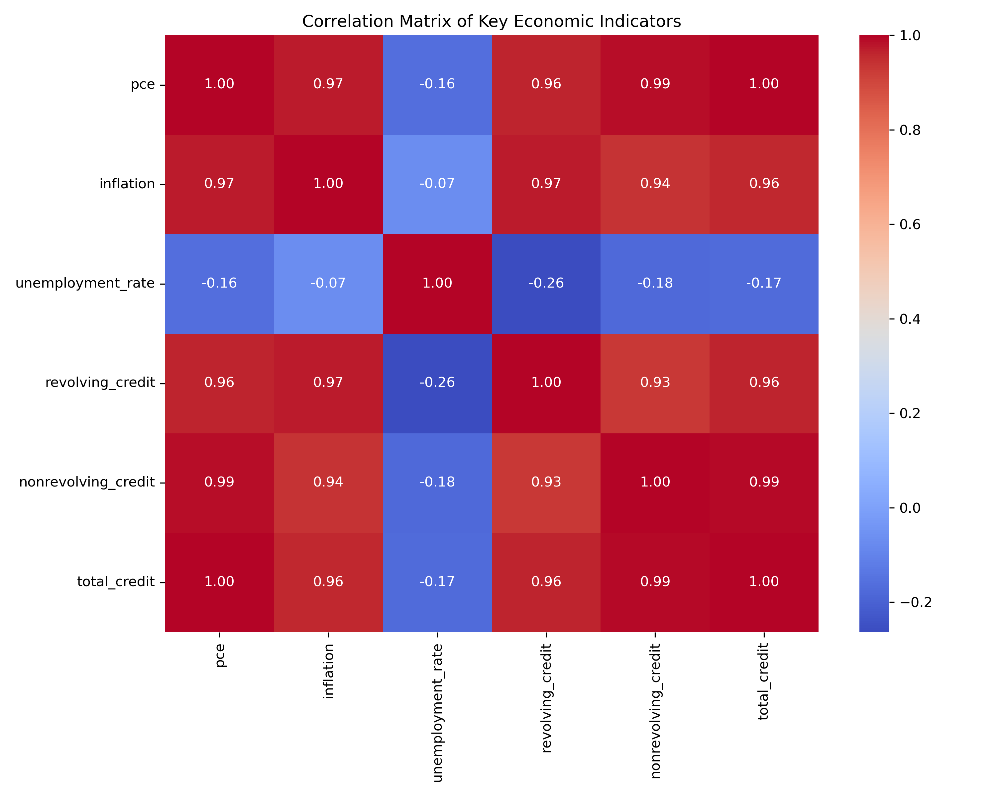
Economic Indicator Correlation

Slide 8
Model Selection And Forecasting

Slide 9
Model Setup
Used TimeSeriesSplit for cross validation in 5 year training and testing splits
Models Tested:
Baseline
Lasso Regression
Ridge Regression
Linear Regression
XG Boost Regressor
Random Forest Regressor
Cat Boost Regressor
Evaluated performance based on r squared and mean square error values

Slide 10
Model Selection
Model | Average R2 Value | Average Mean Squared Error
Baseline | 0.97 | 762,718.78
Lasso Regression | 0.83 | 151,706.30
Ridge Regression | 0.77 | 189,462.32
Linear Regression | 0.73 | 189,252.52
XG Boost Regressor | (4.14) | 3,978,750.33
Random Forest Regressor | (4.89) | 3,483,571.57
Cat Boost Regressor | (6.29) | 3,953,767.82

Slide 11
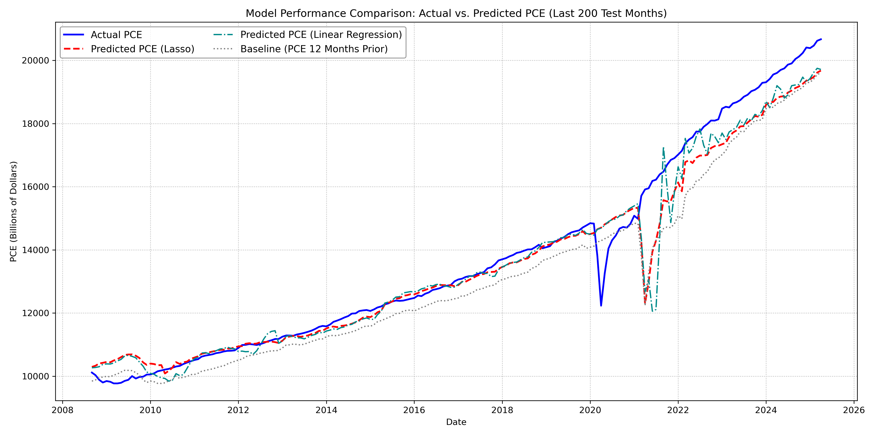
Testing Actual VS Predicted

Slide 12
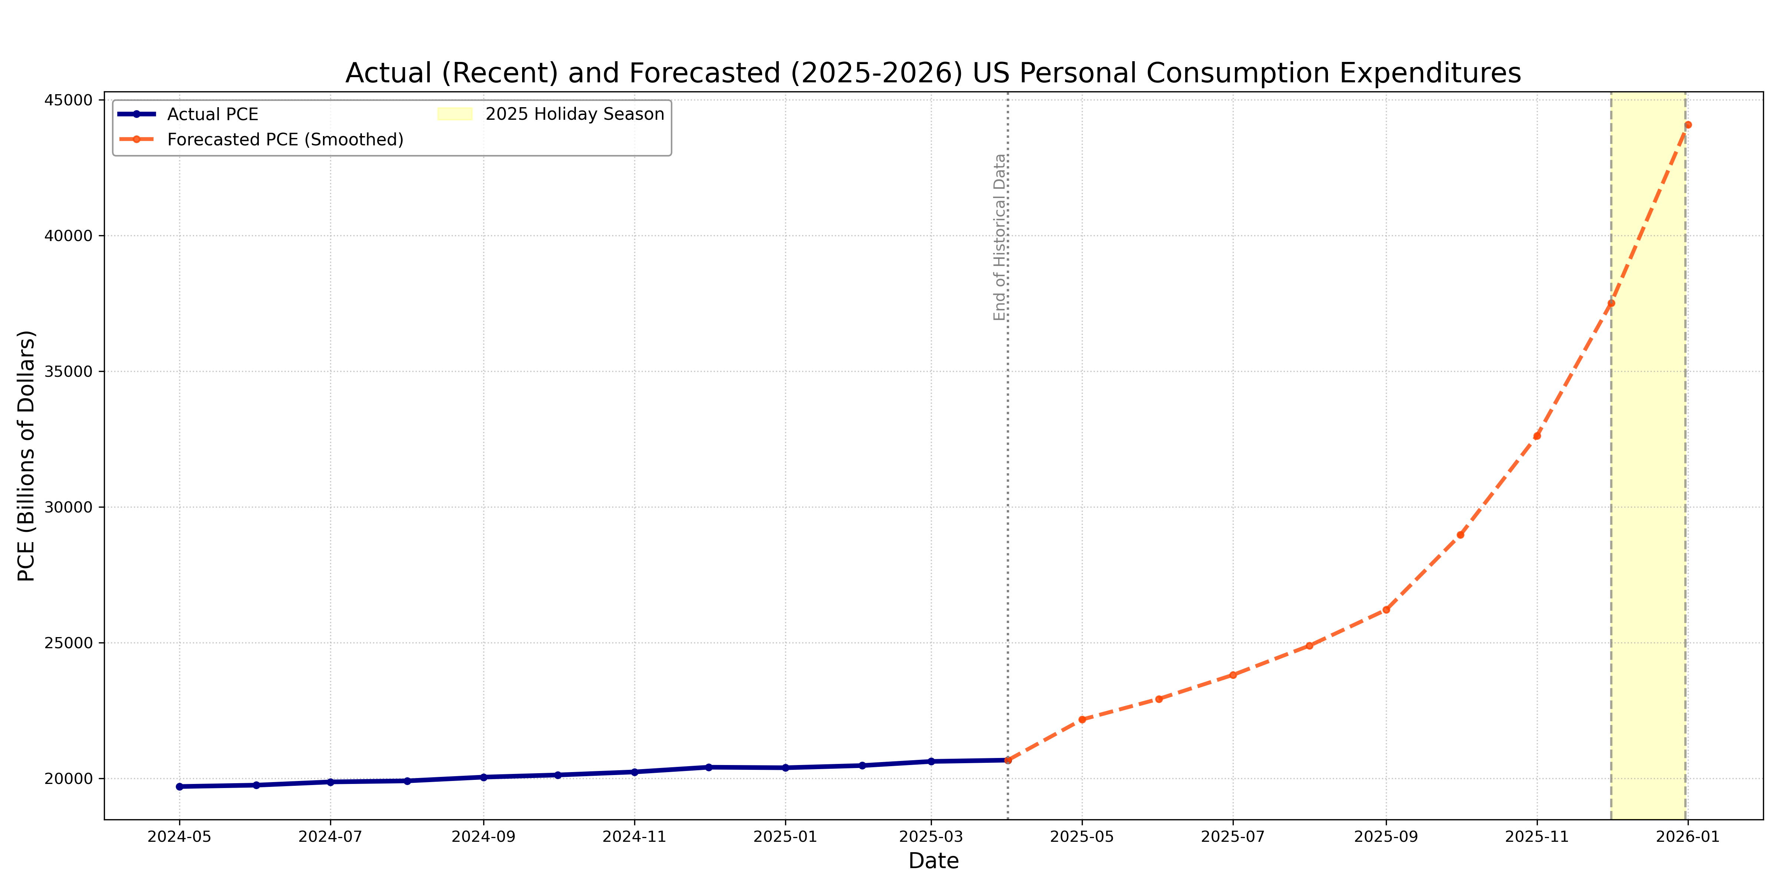
Forecasted December 2025 Spending (12 Months)

Slide 13
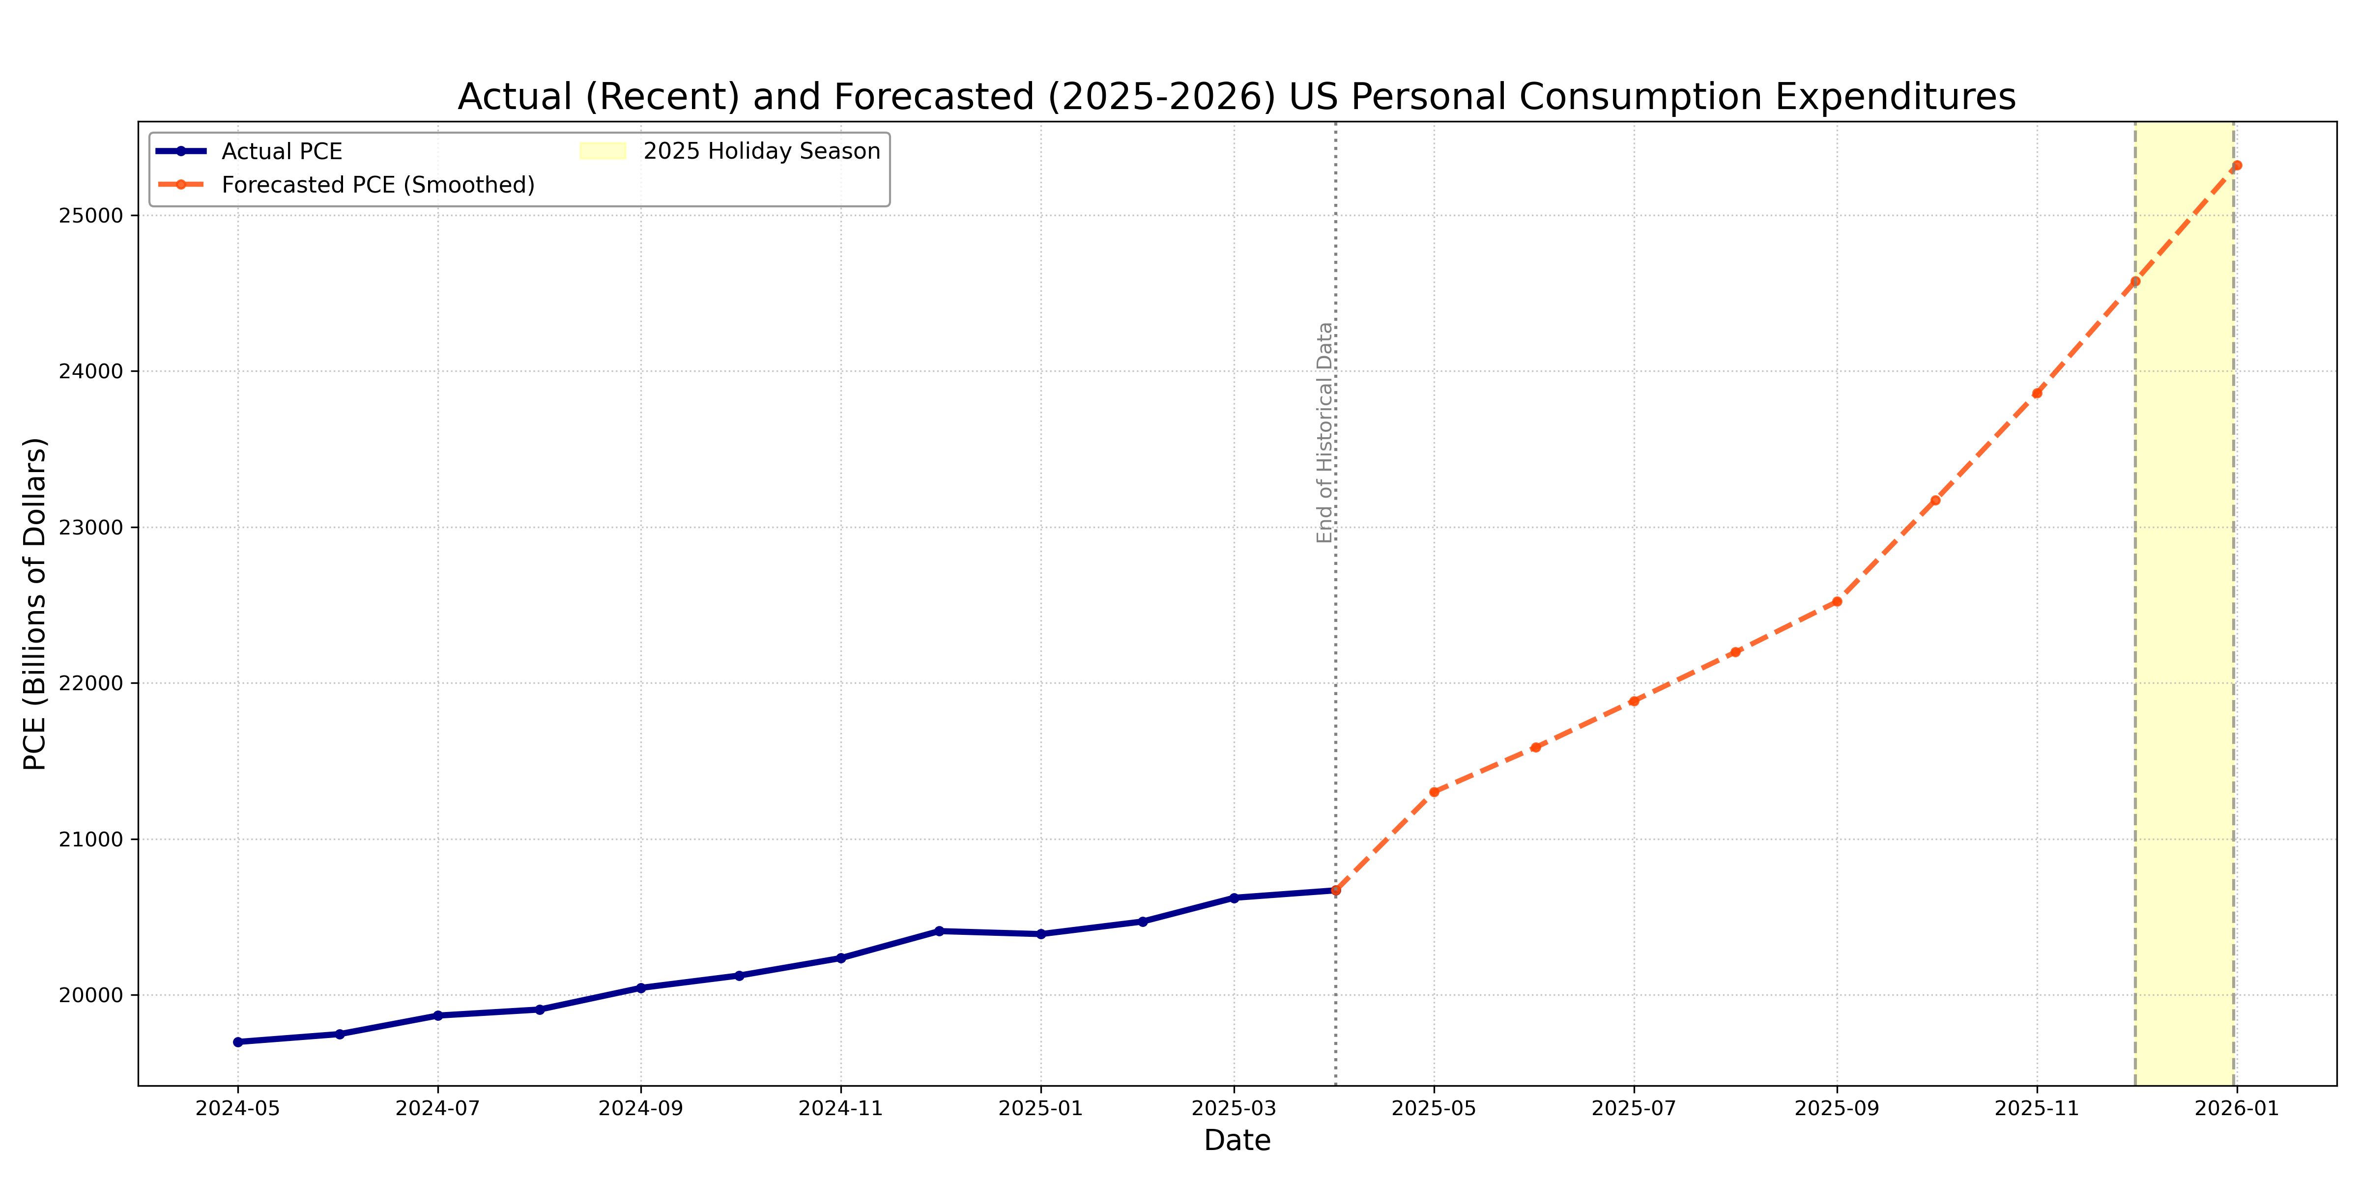
Forecasted December 2025 Spending (6 Months)

Slide 14

Questions? Thank you
Vicki Taylor
vtaylor85@live.com
github.com/vickitaylor/

Slide 15
Company overview

Slide 16
Product benefits
Online store and market swap

Slide 17
Product overview
Unique
First to market
Tested
Authentic
Only product specifically dedicated to this niche market
First beautifully designed product that's both stylish and functional
Conducted testing with college students in the area
Designed with the help and input of experts in the field

Slide 18
Market overview
Opportunity to build
Fully inclusive market
Total addressable market
Freedom to invent
Selectively inclusive market
Serviceable available market
 | Clients | Orders | Gross revenue | Net revenue
20XX | 10 | 1100 | $10,000 | $7,000
20XX | 20 | 200 | $20,000 | $16,000
20XX | 30 | 300 | $30,000 | $25,000
20XX | 40 | 400 | $40,000 | $30,000

Slide 19
Solution
Our product makes consumer lives easier, and no other product on the market offers the same features
Gen Z (18-25 years old)
Reduce expenses for replacement products
Simple design that gives customers the targeted information they need
Close the gap
Target audience
Cost savings
Easy to use

Slide 20
Data Sources
Sources:
Inflation: Federal Reserve Economic Data
Unemployment: US Bureau of Labor Statistics
Consumer Debt: Federal Reserve
Personal Consumption Expenditures: Bureau of Economic Analysis

